Slide 1
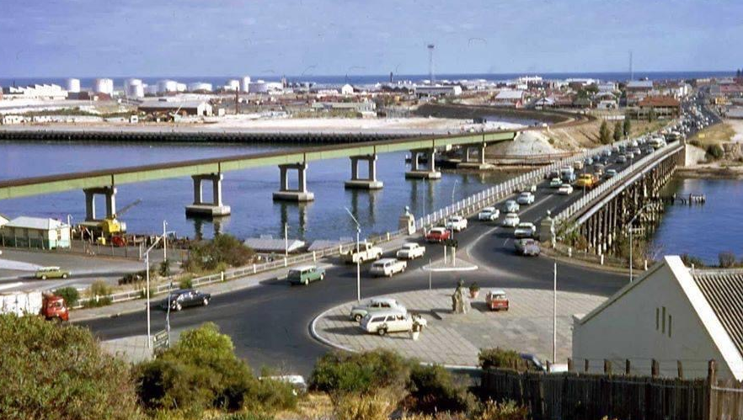
A Better Bridge is Possible
Mayor Brad Pettitt

Slide 2
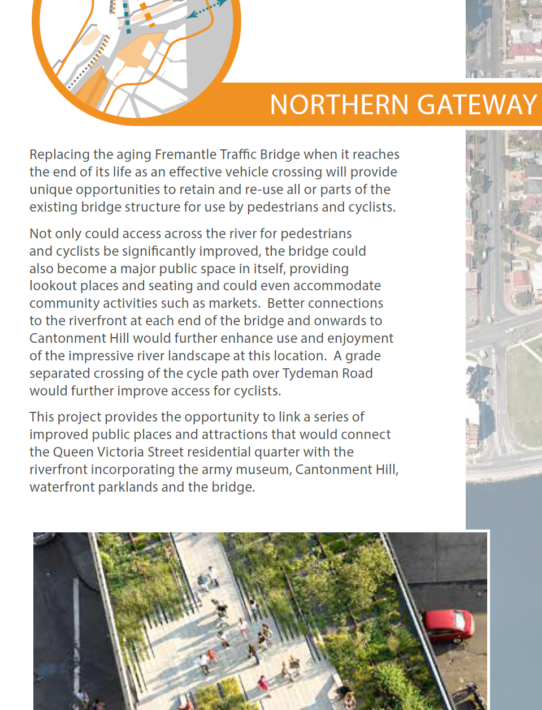
Key elements of Freo 2029
New bridge to the West
Old bridge reused for pedestrians and as public space
Better connections each end
Separated cycle crossings

Slide 3
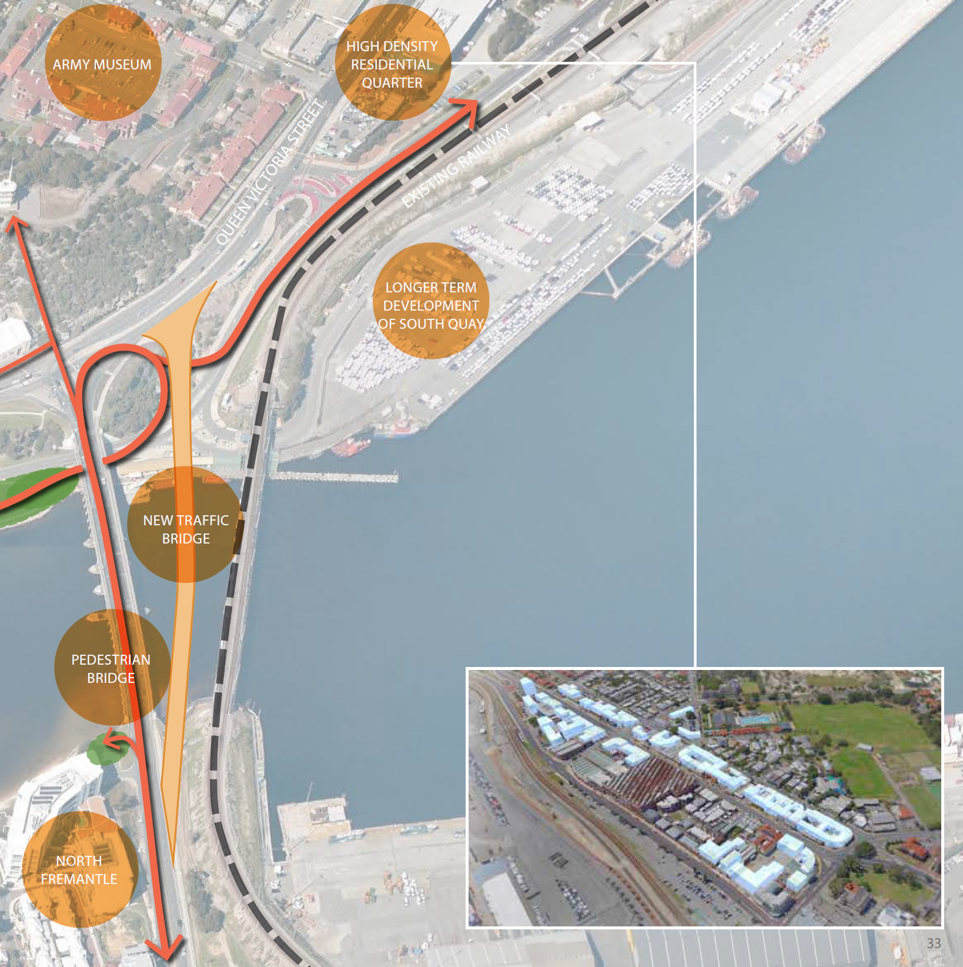

Slide 4
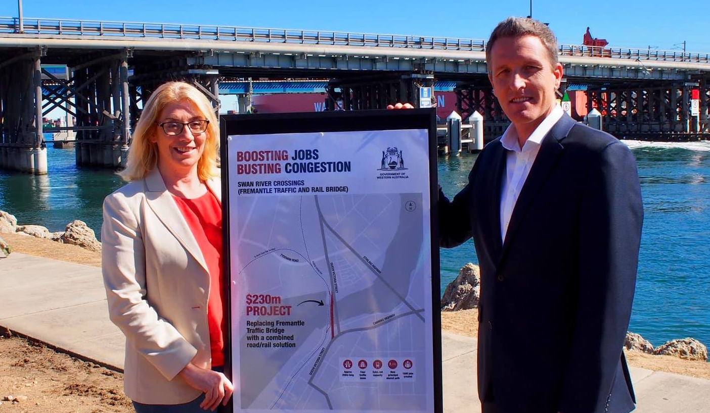
Original government announcement was largely consistent with Freo2029

Slide 5
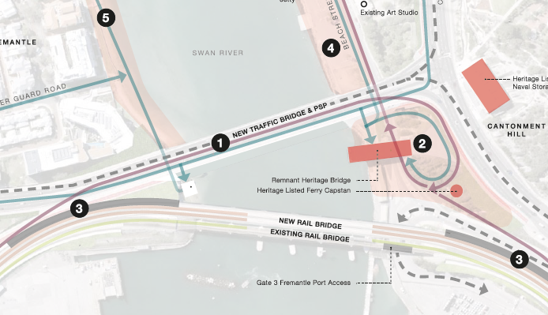

Slide 6
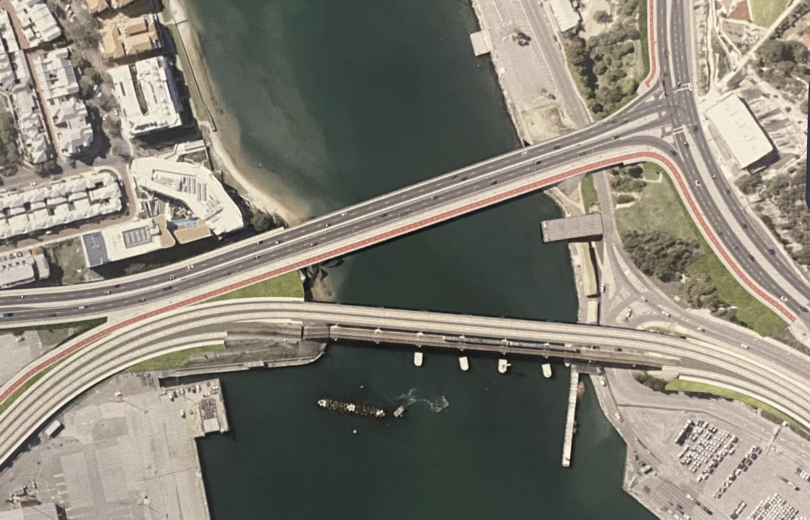

Slide 7
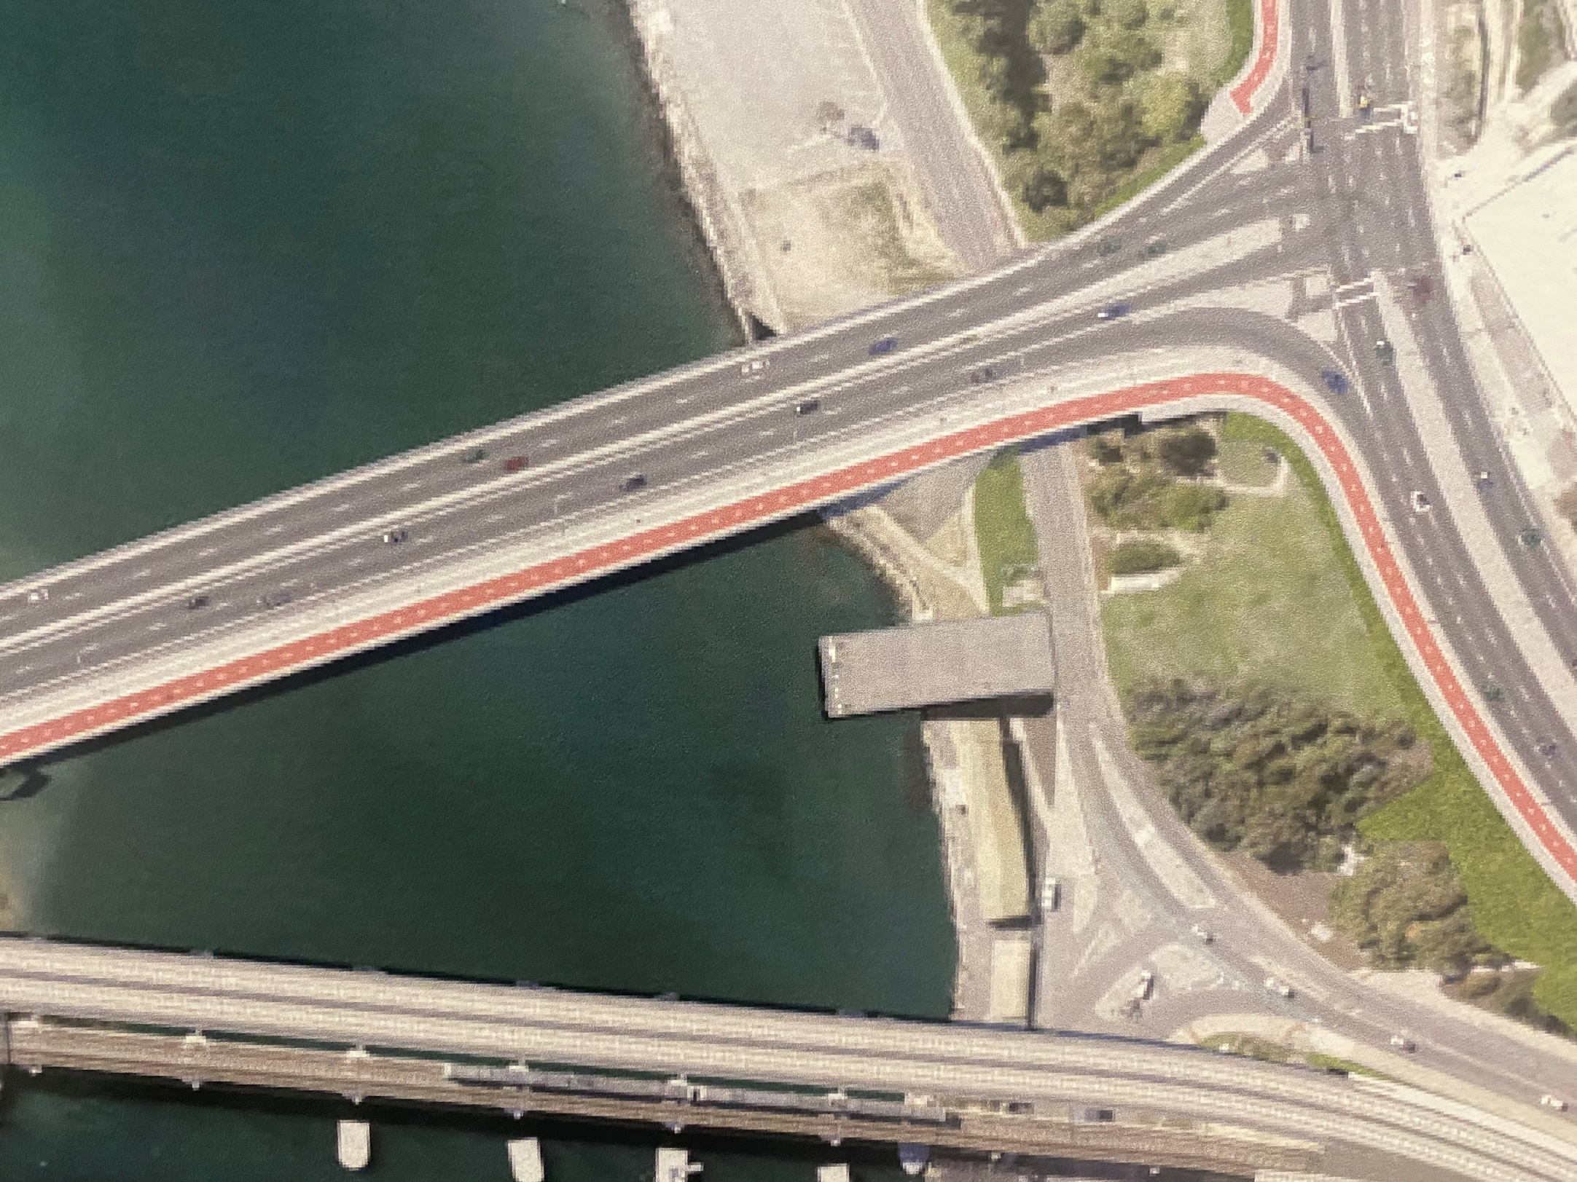

Slide 8
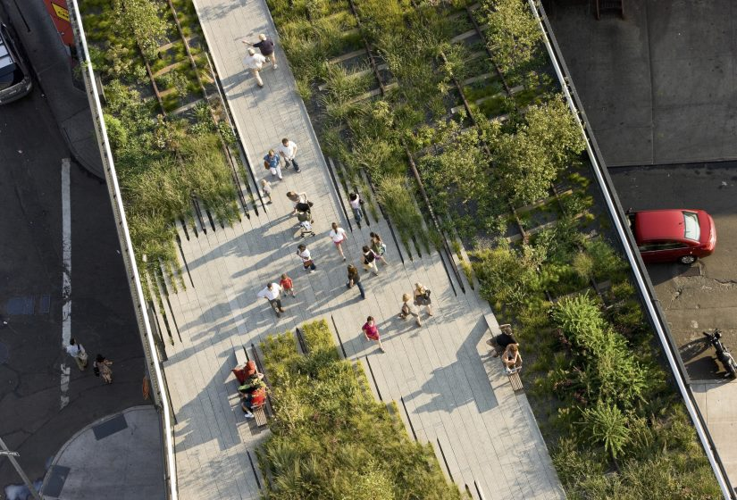
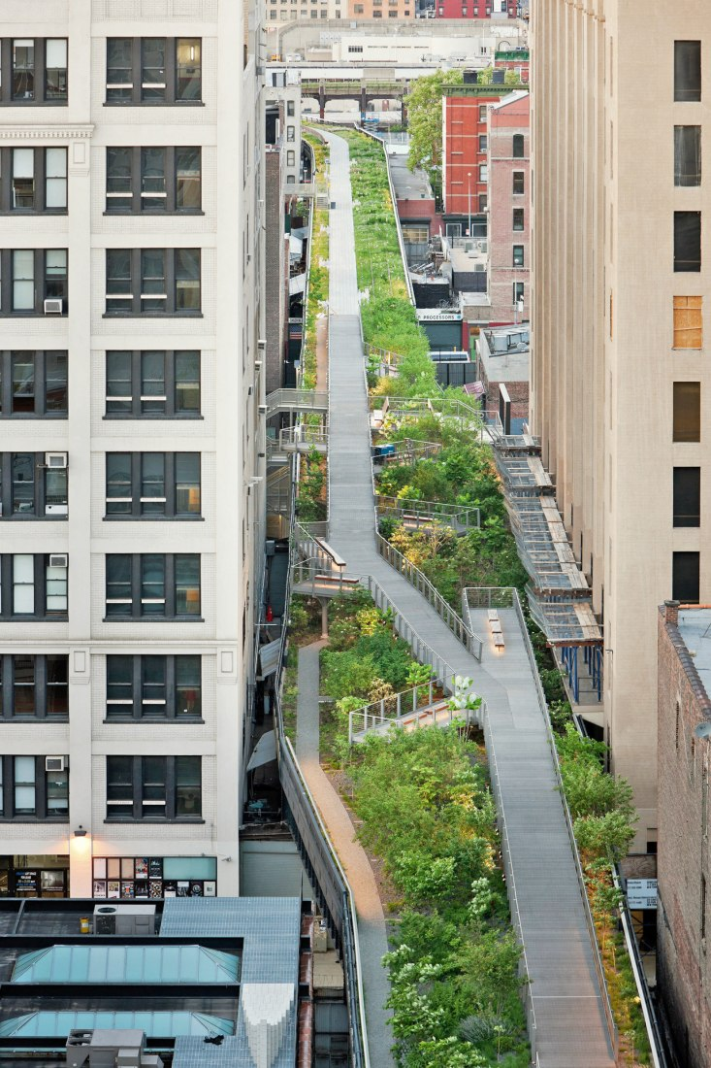
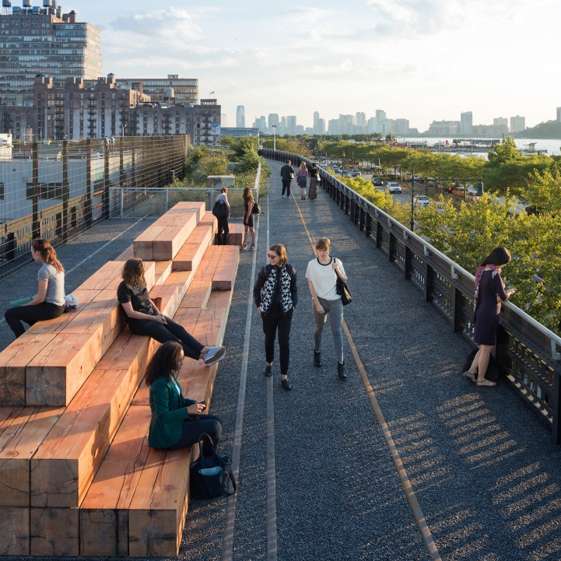

Slide 9
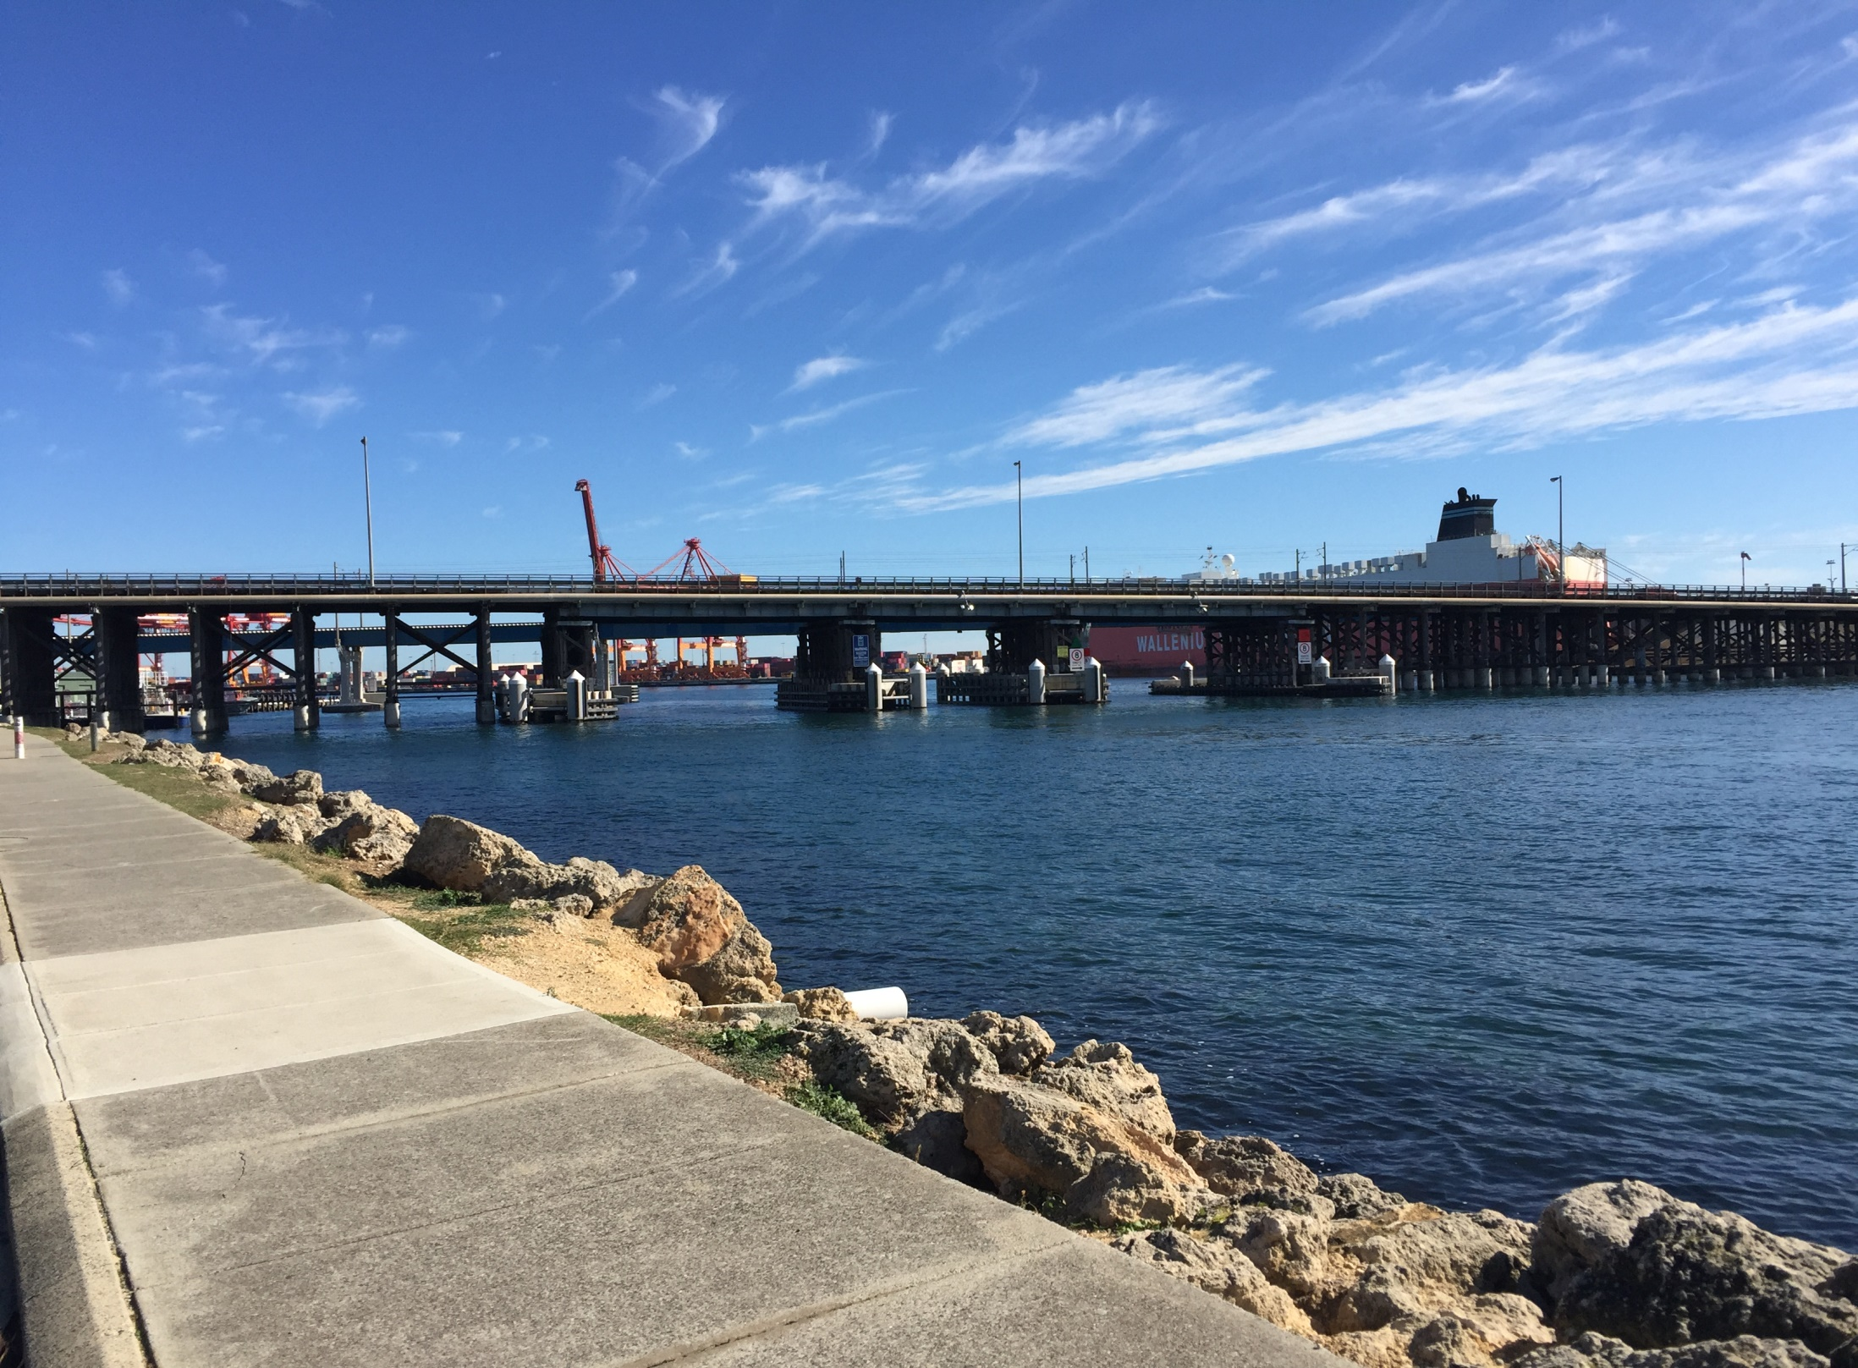
Potential Heritage Reactivation Solution g

Slide 10


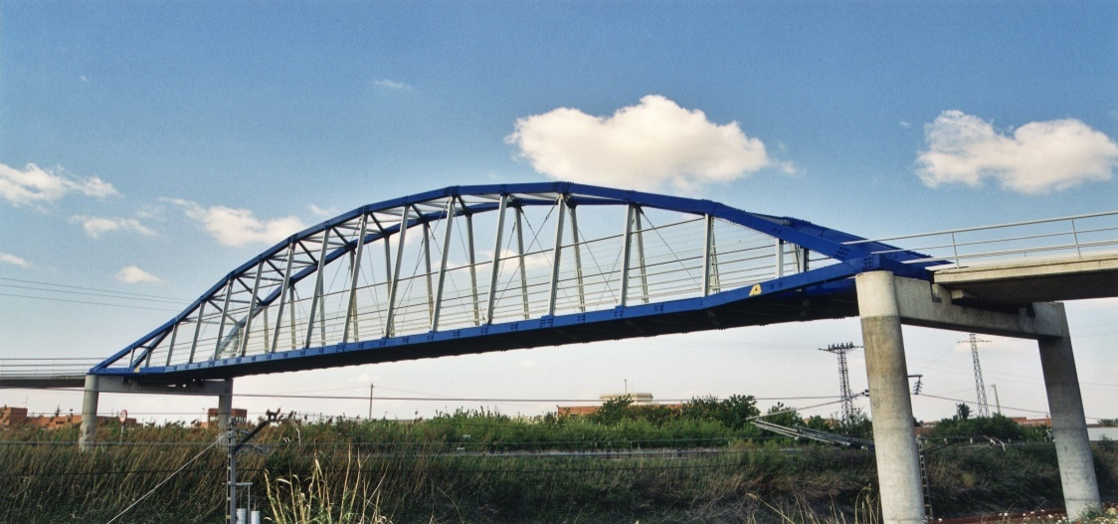


With new central section

Slide 11



The reality of a new bridge next to old structure

Slide 12
With new central section

Slide 13


Swan River Crossing
WESTSIDE OPTION
Central section of Old Traffic Bridge replaced with new structure for pedestrians and low speed /local cycling.
New Traffic Bridge
High-speed, free-flow PSP on east side of existing rail bridge
Either no additional rail bridge, or, new rail bridge downstream from existing

